Slide 1
Rating Prediction
Presented by:
R.Sujanitha

Slide 2
Introduction
We have a client who has a website where people write different reviews for technical products.
Now they are adding a new feature to their website i.e. The reviewer will have to add stars(rating) as well with the review.
The rating is out 5 stars and it only has 5 options available 1 star, 2 stars, 3 stars, 4 stars, 5 stars.
Now they want to predict ratings for the reviews which were written in the past and they don’t have a rating.
So, we have to build an application which can predict the rating by seeing the review.

Slide 3
Hardware and Software Requirements
There is no such requirement for hardware ,but I have used intel processor.
Software: Jupyter Notebook (Anaconda 3), Microsoft Word, Microsoft PowerPoint
Language: Python
Libraries used in project:
Pandas
Numpy

Slide 4
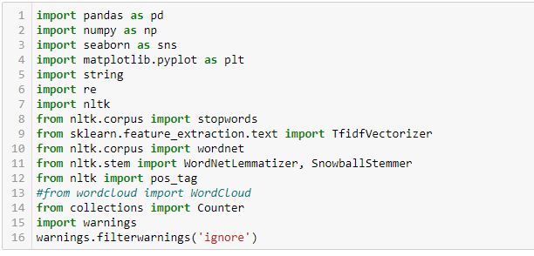
Data Sources and their formats
Our data source is FlipRobo Technologies, who told to scrap the data using selenium from websites and store it and use it.
Before loading the dataset we imported some libraries for loading and analysing our dataset

Slide 5
Web Scraping strategy employed
Selenium will be used for web scraping data from https://www.amazon.in/product-reviews/B07BS4TJ43/
Selecting features to be scrap from website
After extracting the details stored the data in the csv file

Slide 6
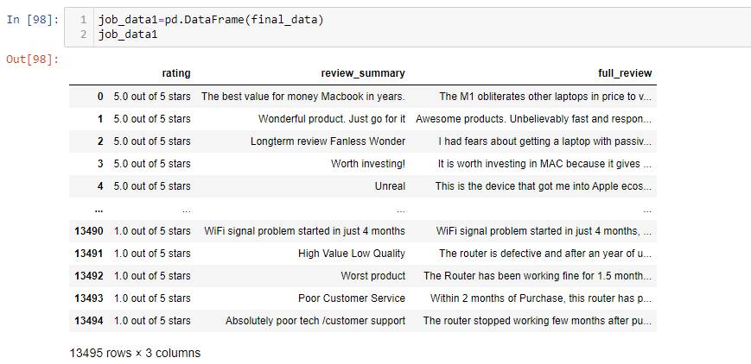

Slide 7
Data Preperation
With the help of the pandas library we upload our data to jupyter notebook
Once our data is uploaded with the help of predefined method(i.e.read_csv) we can read data for further processing.
We have two types of variables available in the data.
Dependent variable
Independent variable

Slide 8
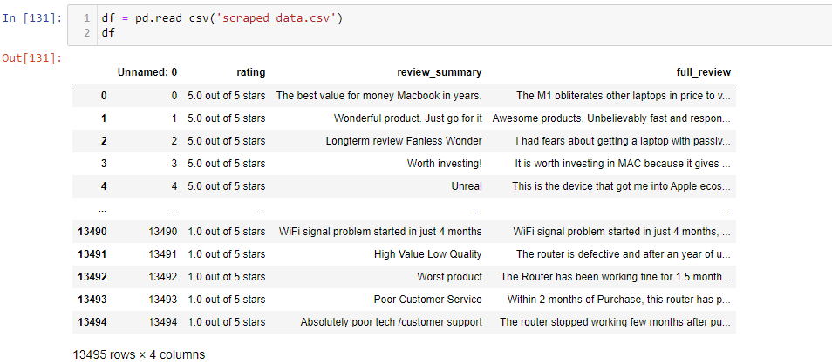

Slide 9
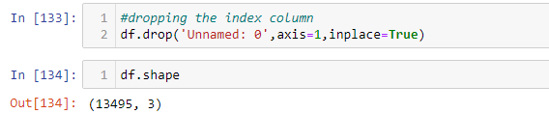
Data Set Information
Dataset contains ratings and reviews
Dataset has 13495 rows and 3 columns

Slide 10
Data Preprocessing
The complete data is divided in the ratio of 80:20 for train and test respectively
There is no null value present in the dataset and almost all the columns type is objective so, we don’t need to check for outliers.
Once our data is ready, we’ll do further processing
I have not dropped any column since the model accuracy is good.

Slide 11
Evaluation Process
Evaluation Matrices:
Accuracy- it determines how often a model predicts default and non default correctly.
Accuracy= Number of correct predictions/Total Number of predictions
Precision: it calculates whenever our models predict it is default how often it is correct.
Recall- Recall regulate the actual default that the model is actually predict.
Precision Recall Curve- PRC will display the tradeoff between precision and
Recall threshold.
Cross validations:
K fold cross validation, k=5

Slide 12
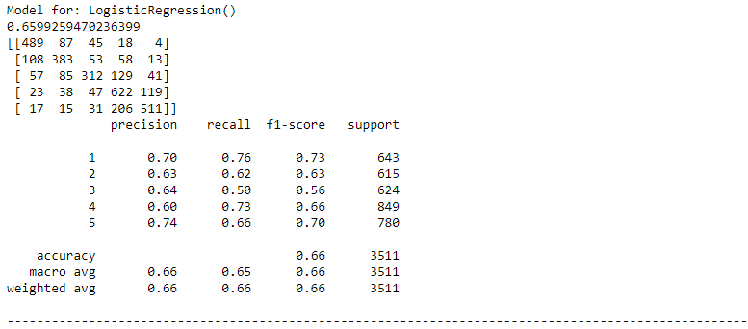
Logistic Regression

Slide 13
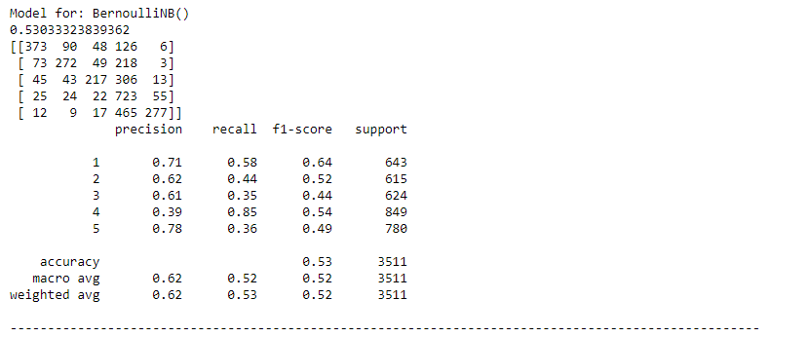
BernouliNB

Slide 14
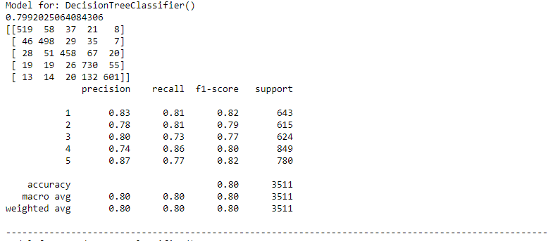
Decision Tree Classifier

Slide 15
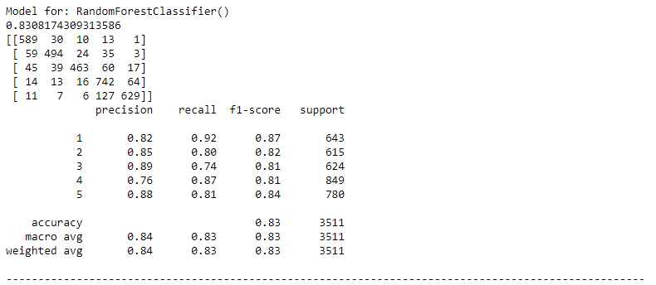
Random Forest Classifier

Slide 16
Result:
From the details on the above solutions it is clearly understand that we are getting best with the help of Random Forest Classifier, so we save this model with the help of joblib library

Slide 17
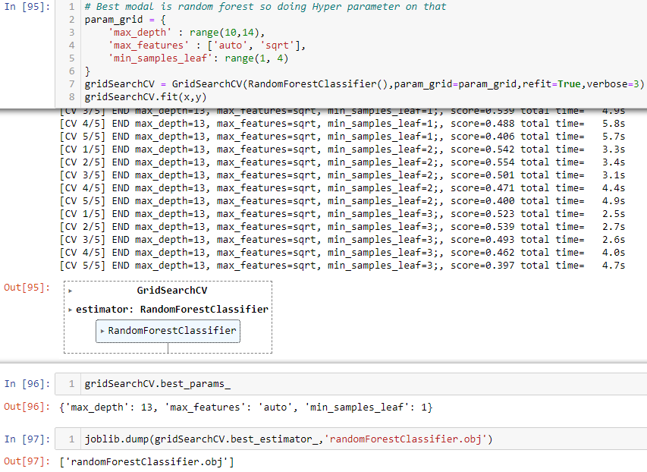

Slide 18
Conclusion
As we know data is increasing every second in our day to day life. So more the data better the model.
If we make this data for sentiment analysis, we choose ratings 3 or more as our threshold for being helpful reviews or good or positive reviews and below 3 we choose reviews is not helpful or bad reviews or negative reviews.
For eg: two people give their reviews on a product as ‘ a nice product. But their ratings are ‘4’ and ‘5’ respectively. This is where the model fails to predict whether to choose rating ‘4’ or ‘5’.
Due to increase in data in our daily basis, this model can be used to predict ratings of reviews.
It might be a good tool for online shopping sites and manufacturer companies who may predict their customers ratings so that they can make their investment according to the demand of customers, which might help them to save time and earn more profits.

Slide 19
Thank you

